Slide 1





LENGTH OF HOSPITAL STAY PREDICTION
SUBMITTED TO:
MUHAMMAD SHAHID
SUBMITTED BY:
JASPREET KAUR (0730470) KANCHAN BAGGA (0732356) VARINDERJIT SINGH (0730482)

Slide 2

OVERVIEW
Problem Statement
Introduction
Objectives
Dataset
Data Source
Factors
Analytical Problem
Ethical Concerns
Methodology
Challenges
Project Contribution
References

Slide 3
PROBLEM STATEMENT
The assumption of early possibility of preadmission stage to observe the hospital admission management team’s cure process and its quality after checkup we are creating Length of stay(LOS) of general patients at emergency department by timing of initial visit.

Slide 4

INTRODUCTION
LOS: LOS means length of stay which directly describes the time interval of a patient’s entry to the exit from the hospital. It depends upon their condition as well like according to the health emergency it will access the period of cure. If the disease is small then it can done within short time, but in case of emergency it take long time to recover the patient’s health issue. This can also help to recognize the room and bed allotment that how much time they need to stay there and require the bed.

Slide 5
OBJECTIVE
Bed allocation
Quality of care
Medical staff
Time access
Proper equipment
Measure of readmission and discharges
Reduce the length of stay

Slide 6
DATASET
Our dataset is MIMIC-III (Medical Information Mart for Intensive Care). It is a huge, single focus database involving data identifying with patients admitted to basic consideration units at in enormous tertiary consideration emergency clinic. In that dataset contains the 26 tables which one table has 7544 rows and 17 columns. This was uncleaned dataset. We had enough null values in our dataset. We had abundant the data to training and testing purpose to predict the accuracy.

Slide 7

DATA SOURCE
MIMIC-III (Medical Information Mart for Intensive Care)
Opensource data
26 CSV files
Link
https://physionet.org/content/mimiciii/1.4/

Slide 8
FACTORS
Age
gender
Marital status
Admission type
History of previous admission
Patient’s condition at discharge time
Type of treatment
Payment method

Slide 9
ANALTICAL PROBLEM
It troubles us to clean the dataset and remove the null values because of having numerous rows and columns for which it requires to use excel.
To analyze further, we need to sort the columns and establish a connections between the columns using tableau and sql.
The main motive to choose python for its features and model selection as it needs neural networks for prediction which can be only capable by python to solve the problem.
To solve the analytical problem it must to think analytical.

Slide 10
ETHICAL CONCERNS
Consent: This dataset requires to get consent from Beth Israel Deaconess Medical Center in Boston, Massachusetts to use it for research purpose at international level. Basically, it provides the access to research in academic and industrial field.
Consistency: This datasets is includes range of records for reasonable experimenting to determine the accuracy of different models is reliable and analogous.
Clarity: This dataset clarify the time interval of a patient to spend in hospital by building the model LOS, which is useful to assume the data on the basis of time length.

Slide 11
CONTINUE WITH FIVE C’s
Control: We can never manipulate with the dataset as it is depends on the original data from the site Physionet. We can use it for the purpose of experimenting but can never make any changes officially as can do some addition or cutting for cleaning purpose to make it easy and understandable as per requirement in the rough replica of real dataset.
Consequences: The aim of this dataset is not to manipulate or any harm to the patient or official documents. It is just to help the hospital authority or management team to assume the stay time of patient in the hospital to get recover.

Slide 12
METHODOLOGY
Logistic Regression
Gradient Boosting
Neural networks
Random Forest
Confusion Matrix

Slide 13
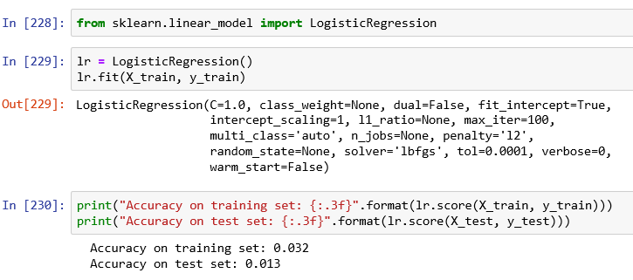
LOGISTIC REGRESSION
Logistic Regression is suitable option for regression analysis to conduct when the contingent on adaptable is dualistic.

Slide 14
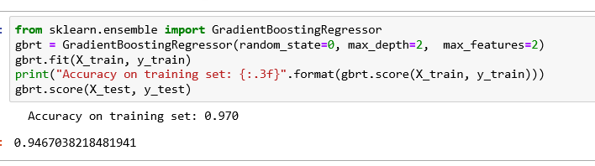
GRADIENT BOOSTING
Gradient boosting is basic technique of machine learning for regression and sorting problems that is helpful for prediction model in the way to collaborative of fragile prediction models, typically decision trees.

Slide 15
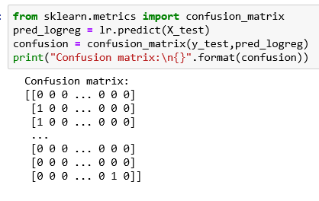
CONFUSION MATRIX
Confusion matrix is a table description of the performance of a sorting model on a dataset for which the accurate values are identified. This type is used often.

Slide 16
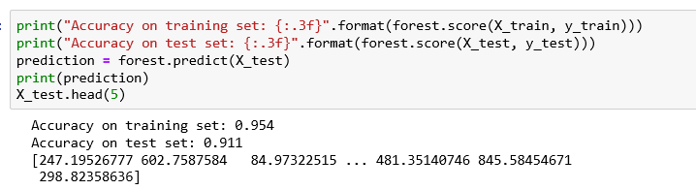
RANDOM FOREST
Random forest are an collaborative learning method for sorting, regression tasks that function by building a host of decision trees at training time and outputting the class that is the way to periods prediction of entities trees.

Slide 17
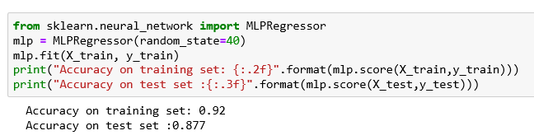
NEURAL NETWORKS
Multilayer perception or MLP’s are the classical type of neural networks that are compromised of one or more layers of neurons in which the Data is nourished to the internal layer, there may be one or more secreted layers in case levels of concept, and prediction are made on the external layer.

Slide 18
CHALLENGES
Initially, it troubles to find the dataset
The it takes the long time to get access or permission from authority on legal base.
Moreover, it gives enormous choices that make it complicated to select one of these.
The dataset includes lots of diagnoses that’s why it is difficult to give the priority to anyone among all for the prediction.
While we were doing coding part the accuracy rates remain very low.
Due to the low accuracy we had to repeat the splitting part change the ratio to improve the accuracy.
Current Scenario of COVID-19 affect the project work highly as we cancelled all the group meetings to maintain social distancing.

Slide 19
Project Contribution
Major Task | Member Name | Sub Tasks | Description | Completed on | Status
Topic selection | Kanchan Bagga | Finding project topic, Topic related search | Project that could be useful in future. Should have something new. Scope for job placement. Should be useful in real life as a tool. | February 04, 2020 | Done
Dataset | Jaspreet Kaur | Finding dataset (Searching, getting access and downloading) | Searched dataset from different websites. Sent emails to many of the organizations for accessing their datasets. Got access for MIMIC dataset and downloaded | February 18, 2020 | Done
 | Jaspreet Kaur Kanchan Bagga Varinderjit Singh | Target and supporting variables selection | Target variable (LOS) was already cleared in everyone’s mind but all the supporting variables were needed to select that could effect on LOS. | February 25, 2020 | Done
 | Kanchan Bagga | Data Cleaning (Changing format, keeping necessary data only) using excel | Changed downloaded files format. Made one single file from 27 files by merging all necessary columns in master file only. Removed unnecessary columns only, removed outliers, data about emergency department only was kept. Some new columns are made. Missing data rows are removed. | March 03, 2020 | Done
 | Varinderjit Singh | Cleaned data understanding & exploration | Understood & explored cleaned data in SQL Server for my satisfaction and cross checking. | March 05, 2020 | Done

Slide 20
Project related research | Jaspreet Kaur | Searching work done on related projects | Projects that are already made on same topic. So that we could come to know what is done and what different we can do. | March 03,2020 | Done
Article reading | Varinderjit Singh Kanchan Bagga Jaspreet Kaur | Studied 10 (4-3-3) articles individually | Study articles based on how we can use machine learning in our project. For understanding what kind of models, we can use and how we can improve their accuracy. | March 12, 2020 | Done
Model Study | Jaspreet Kaur | ANN, Logistic regression, K-neighbor | YouTube tutorials, Google search | March 23, 2020 | Done
 | Kanchan Bagga | CNN, Random forest, Gradient boosting | YouTube tutorials, Google search | March 19, 2020 | Done
 | Varinderjit Singh | Confusion matrix, Multiple linear regression | YouTube tutorials, Google search | March 20, 2020 | Done
Model Building | Varinderjit Singh | Neural network, Multiple linear regression, Confusion matrix |  | - - - | Pending
 | Kanchan Bagga | Random forest, Gradient boosting |  | March 24, 2020 | Done
 | Jaspreet Kaur | Logistic regression, K-neighbor |  | March 24, 2020 | Done
Report writing | Jaspreet Kaur |  |  | - - - | Pending
Presentation | Kanchan Bagga |  |  | - - - | Pending

Slide 21
REFERENCES
https://physionet.org/content/mimiciii/1.4/
https://towardsdatascience.com/predicting-hospital-length-of-stay-at-time-of-admission-55dfdfe69598
https://www.nature.com/articles/sdata201635
https://www.ncbi.nlm.nih.gov/pmc/articles/PMC1067345/

Slide 22

THANK YOU

